Slide 1

2021 Poster Contest Healthy Forests, Healthy Communities
NACD/NACD Auxiliary Poster Contest
Ideas, Rules, Poster Ideas and Tips
Notes:
Level 2 Grades 2-3 National Association of Conservation Districts http://www.nacdnet.org/education/we-all-need-trees

Slide 2
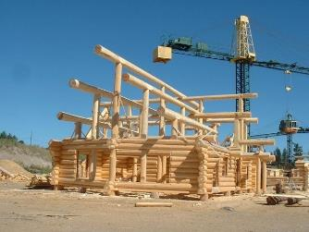
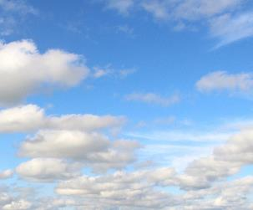
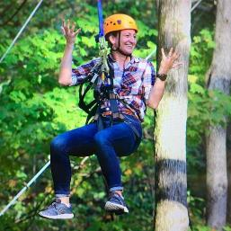
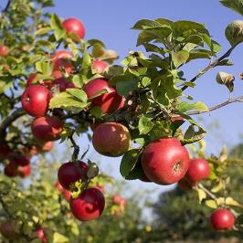
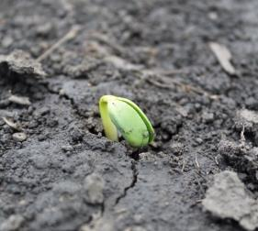
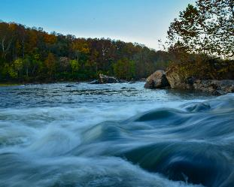




Have you thought about a tree today?
Every day, forests and trees play an important role in our lives.
Trees provide many benefits:
Recreation
Clean Air
Healthy Soil
Clean Water
Healthy People
Food and Products
Heathy Communities
www.nacdnet.org
Notes:
We use trees every day in more ways than you think! In fact, without trees and other green plants we wouldn't be alive!

Slide 3
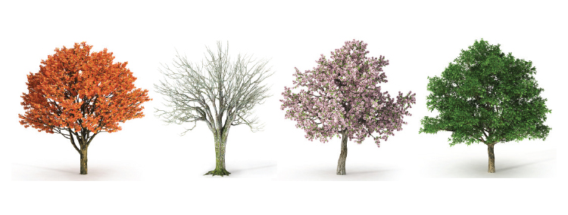
How do trees grow?
A tree grows in three ways:
1. Its crown gets taller.
The branches and leaves that extend from the trunk of the tree or main stems.
2. Its trunk gets wider.
The trunk gives the tree support to help keep it from falling and holds up the crown.
3. Its roots go deeper into the soil.
The roots go down very deep and hold the tree in place.
www.nacdnet.org
Notes:
The crown of a tree has a very important job! The crown of a tree is made up of the leaves, twigs and branches
that form the top of the tree. Remember, the leaves in the crown collect energy from the sun and use it to make air for us to breathe! Every tree needs a trunk!
The trunk of the tree is the part that is above the soil and is covered with bark. It gives the tree support to help keep it from falling down and holds up the crown.

Slide 4
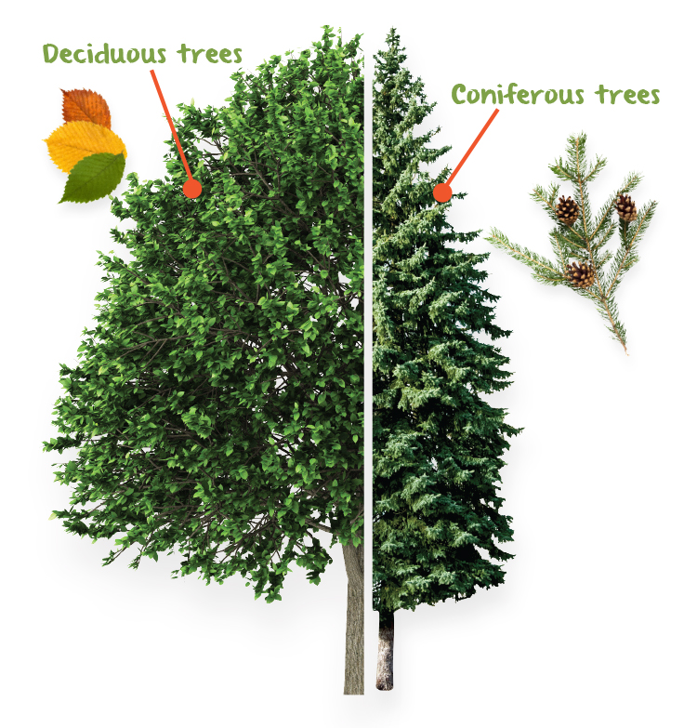
Not all trees are alike.
There are two basic types of trees to look for:
deciduous or hardwoods and
coniferous or softwoods
www.nacdnet.org
Notes:
Forests are found all over planet Earth. One of the ways forests are classified is by the types of trees most commonly found in them. There are two basic types of trees to look for - deciduous and coniferous. Deciduous trees are also referred to as hardwoods. These trees have broad, flat leaves that fall off in the fall season and their seeds are produced in clusters or in fruits. Deciduous trees include: oak, maple, hickory and apple trees. Coniferous trees are also referred to as softwoods. Conifers have needle-shaped leaves that stay green year-round and their seeds are produced in cones. Some examples of coniferous trees are: pine, spruce and fir trees.
Whether leaves are needle-like or flat, they are complex "power houses" that we depend upon for the oxygen we need to survive! There is much more to a leaf than meets the eye! Just as we have skin, a leaf has a protective film covering it called a cuticle. Beneath the cuticle is an outer layer of cells called the epidermis that protects the leaf from water loss which is very important during times of drought or high temperatures.

Slide 5
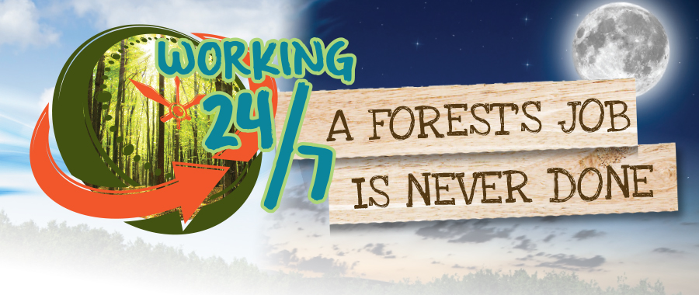
Forest's work 24/7!
www.nacdnet.org
Notes:
Forests are alive and working 24 hours a day and 7 days a week. You should be very happy that they never stop working because you need something 24 hours a day and 7 days a week that they provide for you - the OXYGEN in the air that you breathe!

Slide 6
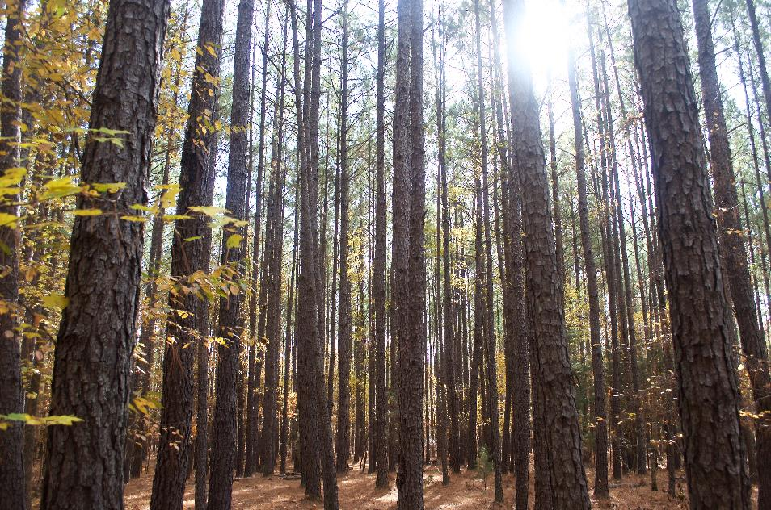
How many trees do we need to breathe?
www.nacdnet.org
Notes:
One large tree can make enough oxygen in one day for 2 people. How many breaths do you think you take each day? You breathe in oxygen and breathe out carbon dioxide with every breath. Trees use the carbon dioxide you breathe out and make most of the oxygen you breathe in every day. Your brain and the rest of your body can’t get along without it!
We aren’t the only ones that need the oxygen from trees, animals need it to breathe too. Animals need trees for lots of reasons. Arboreal animals are animals that spend most of their time in trees. A few of these animals are mammals like; squirrels, bats and monkeys. Some are amphibians like frogs or snakes. A lot of birds live in trees.

Slide 7
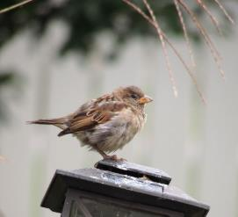
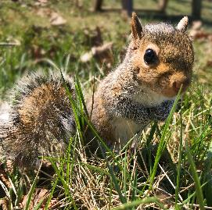
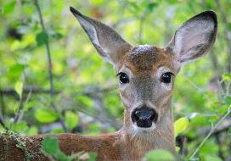
We aren't the only ones who need trees!
Animals and people use trees in the same way!
For a home - we build our homes from trees and some animals use trees as their home.
Food source - both humans and animals eat nuts and fruits that grow on trees.
Keeping cool - both animals and humans use the shade from trees to keep cool.
What other ways can you think of?
www.nacdnet.org
Notes:
Sometimes animals and humans use trees in the same way! Some examples are:
For a home- we build our homes from trees and some animals use trees as their home.
Food source- both humans and animals eat nuts and fruits that grow on trees.
Keeping cool- both animals and humans use the shade from trees to keep cool.
What other ways can you think of?

Slide 8
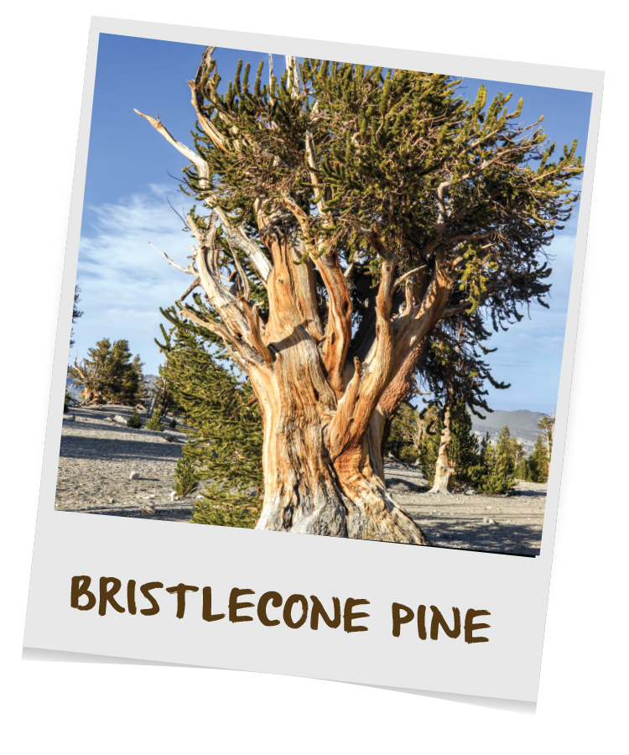
Thousands of years and still alive!
Many forests and trees living in the United States today have been alive for hundreds and even thousands of years.
5,000 years ago a seed germinated on a mountain in what is now Inyo County, California. The seed grew into the oldest living organism on earth, a Bristlecone Pine tree!
www.nacdnet.org
Notes:
Trees have seen it all! Many forests and trees living in the United States today have been alive for hundreds and even thousands of years. They have survived through good times and bad, droughts and floods, and have shared shade with some pretty famous people! Well over 5,000 years ago a seed germinated on a mountain in what is now Inyo County, California. The seed grew into the oldest LIVING organism on earth, a Bristlecone Pine tree!

Slide 9
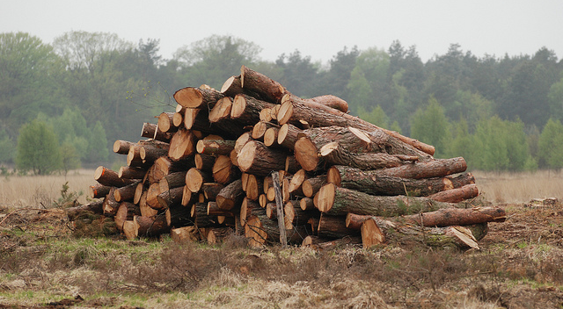
Trees are a valuable natural resource.
Did you know:
A single tree can absorb 48 pounds of carbon dioxide from car emissions per year.
One large tree can remove up to 100 gallons of water out of the soil and release it into the air in a single day.
One person uses enough wood related products per year to equal a 100 foot tree 18 inches in diameter.
www.nacdnet.org
Notes:
Natural resources are created from nature. They are things that we use that cannot be made by people. For example, we use the trees in a forest for wood to build our houses, make cardboard boxes, paper to write on and many other things.

Slide 10
Do Your Part
We need trees. Trees need us. It is important that each of us does our part to care for trees. There are many things we can do:
Control invasive plants on your property and report invasive plant infestations to your local land management agency.
Plant a native tree! If you don’t have yard space, then plant one in a large pot and place it on your deck or porch.
Visit a forest and be sure to stay on marked trails. If you picnic or camp in a forest always be very careful with grills and campfires.
What are some other ideas?
www.nacdnet.org
Notes:
We need trees. Trees need us. It is important that each of us does our part to care for trees. There are many things we can do.
Control invasive plants on your property and report invasive plant infestations to your local land management agency.
Plant a native tree! Plant a native tree! If you don’t have yard space, then plant one in a large pot and place it on your deck or porch.
Visit a forest and be sure to stay on marked trails. If you picnic or camp in a forest always be very careful with grills and campfires.
What are some other ideas?

Slide 11
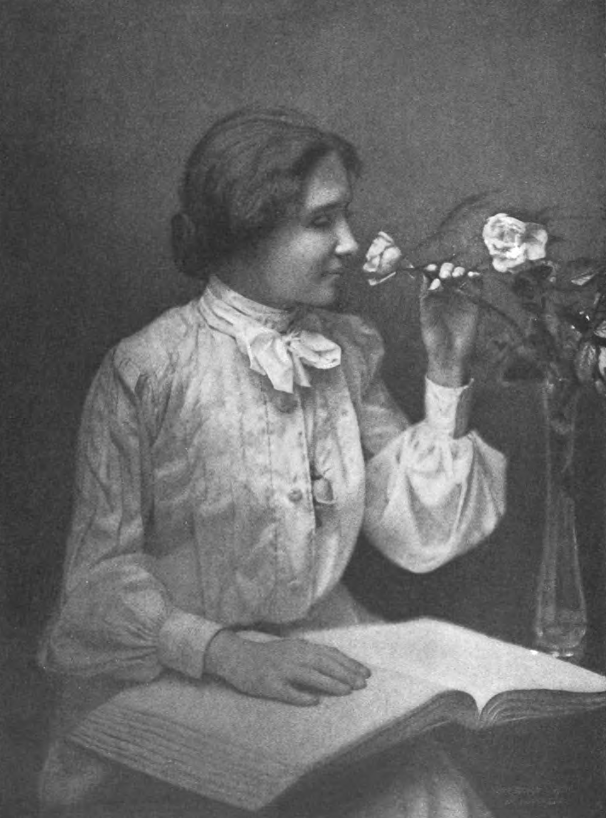
Help is here!
“To me a lush carpet of pine needles or spongy grass is more welcome than the most luxurious Persian rug.” ~ Helen Keller ~
Your local conservation district is eager to help you care for the trees in your community. Contact them for more information.
National Association of Conservation Districts (NACD) http://www.nacdnet.org/general-resources/conservation-district-directory/
www.nacdnet.org
Notes:
Your local conservation district is eager to help you care for your soil. Contact them for information.
National Association of Conservation Districts (NACD) http://www.nacdnet.org/general-resources/conservation-district-directory/
Download the PowerPoint to your computer and add your contact information and some additional slides of projects in your community.

Slide 12
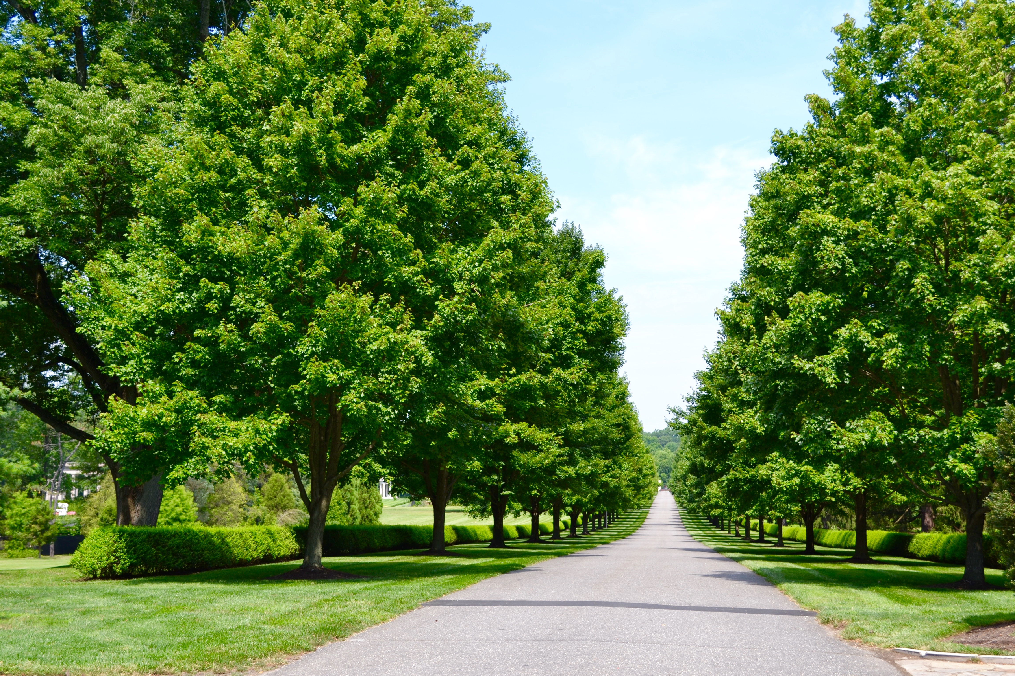
2021 Poster Contest
Healthy Forests, Healthy Communities
The Poster Contest is open to all public, private and homeschooled students in grades K—12.
Contest Categories
K-1st Grade 2nd-3rd Grade 4th-6th Grade 7th-9th Grade 10th-12th Grade
Send entries to your local conservation district:
http://www.nacdnet.org/general-resources/conservation-district-directory/
Contact your conservation district to find out the dates of your local contest!
www.nacdnet.org
Notes:
2021 Categories
Grades K-1
Grades 2-3
Grades 4-6
Grades 7-9
Grades 10-12
Some local and state contests have additional categories
Please note, only posters that go through state contests are eligible for the national contest. Do not send posters directly to the national contest.

Slide 13
Poster Contest Details
Winning entries will be selected by your local district and sent to the state level for judging.
State winner entries will then be sent to the national level, where one overall winner will be selected and announced at the 2021 NACD Annual Meeting in New Orleans, Louisiana on February 7. Winners will be posted to the NACD website.
Monetary prizes will be awarded to the 1st - 3rd place winners in each category at the national level.
$200 for 1st Place Winners
$150 for 2nd Place Winners
$100 for 3rd Place Winners
Monetary awards from the NACD Auxiliary.
www.nacdnet.org

Slide 14
Poster Contest Rules
Poster must be turned in on time for judging.
Attach the poster entry form, signed by a parent or guardian, to the back of the poster.
Entry must be contestant's original creation.
Any media may be used to create a flat poster (ex. paint, crayons, stickers, etc.)
www.nacdnet.org

Slide 15
Poster Contest Rules Cont.
It is the local district/state association/auxiliary/agency’s decision what size and what kind of poster (hand drawn or digital) they accept for your local or state contest.
Only digital posters (photographs or scanned copies of the hand drawn posters in a JPEG format) will be accepted at the national level. Photographs must be clear and well-framed.
www.nacdnet.org

Slide 16
What makes a good Poster?
Attracts attention
Is simple and concise
Uses colors and white space effectively
Text is large enough to be easily read
www.nacdnet.org
Notes:
What makes a good poster?
Attracts attention
Is simple and clear
Uses colors and white space to get and hold attention
Letters are large enough to be easily read

Slide 17
When forming ideas for your poster…
Research the topic of the theme
Brainstorm ideas and make a list
Use the theme as your title:
“Healthy Forests, Healthy Communities”
Use some of the important issues from this presentation
Look around your community for ideas
Talk to professionals in the industry
Research soil health and use the information you find
www.nacdnet.org
Notes:
Research the topic of the theme
Brainstorm ideas and make a list
Think of the theme and use the theme as your title

Slide 18
Poster TIPS
Do…
limit text and balance a combination of illustrations and words.
be as neat as you can and be sure to erase any penciled sketches or guidelines.
blend colors when using crayons or colored pencils.
research the theme topic as a way to brainstorm poster ideas.
www.nacdnet.org

Slide 19
Poster TIPS Cont.
Don’t…
use staples, tacks, or tape.
use fluorescent-colored posters.
create a poster that is all words or all illustrations.
have your parent or others draw your poster for you to color in.
try to include too many ideas. A single message – clearly illustrated – is most effective.
www.nacdnet.org

Slide 20
Judging
Judging Criteria | Weight
Conservation Message | 50%
Visual Effectiveness | 30%
Originality | 10%
Universal Appeal | 10%
www.nacdnet.org

Slide 21
For Additional Information…
Visit https://www.nacdnet.org/conservation-education-hub/
Entry Forms, Rules and Resource files are also available for download on the contest page at:
https://www.nacdnet.org/general-resources/stewardship-and-education-materials/contests/
www.nacdnet.org

Slide 22
ADD LOCAL, AREA, STATE INFORMATION ON DATES AND OTHER CONTEST INFORMATION
www.nacdnet.org
Notes:
Local info – contest dates – contact info

Slide 23
Speech Contest
Add information if you also hold a speech contest on the stewardship theme
Date of speech contest
Open for grades
Length of speech
Contact information
www.nacdnet.org

Slide 24
Essay Contest
Add information if you hold an Essay contest on the Stewardship theme.
Contest open to grades:
Essay length:
Due Date:
Essays entries are to be sent to:
Contact Information
www.nacdnet.org

